Slide 1

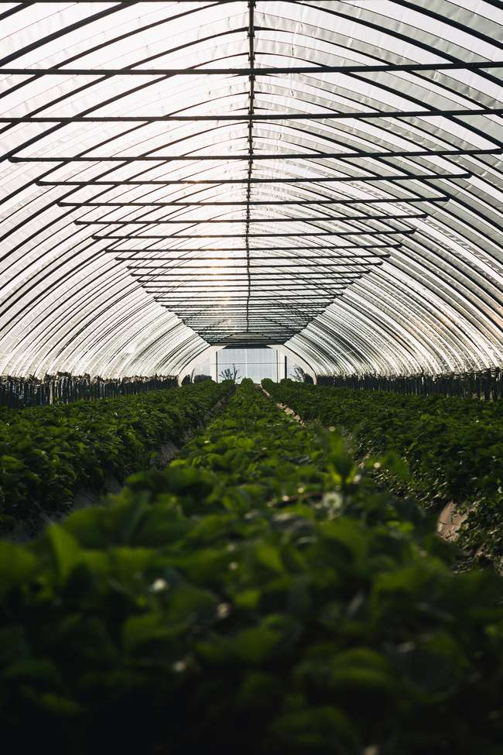


12/19/2024
Smart System
GARDENING
To showcase the design, functionalities, and progress of a smart gardening system that automates plant care using IoT technologies.
ZEINAB GHOLAMPOUR DADAEI
PAGE 01
S6117047@STUDENTI.UNIGE.IT
Notes:
Good morning, everyone. Today, I’m excited to present my project, Smart Gardening System. This project showcases how IoT can enhance gardening through automation, monitoring, and control. Let’s explore how it works and the problems it solves.

Slide 2
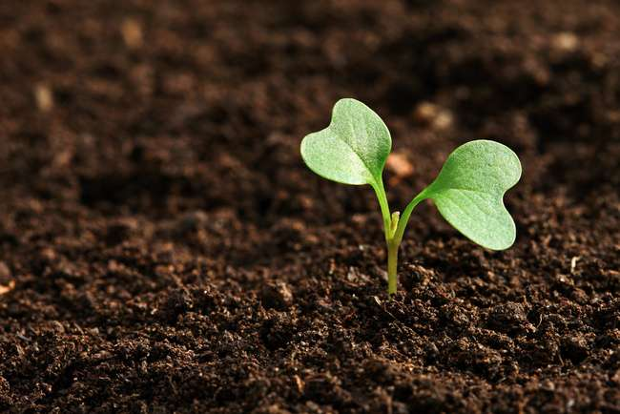
SMART GARDENING SYSTEM
PAGE 02
What is the Smart Gardening System?
“A smart IoT-based system that monitors environmental conditions (temperature and humidity) and allows remote control of actuators for gardening.”
Key Features:
Real-time temperature and humidity monitoring
Remote control of a servo motor and NeoPixel lighting
Automated system feedback for connection status
Notes:
Gardening requires consistent care, but challenges like monitoring environmental conditions or watering plants at the right time often lead to inefficiencies. My project aims to address these issues by providing real-time monitoring of temperature and humidity, remote control of gardening tools, and data logging for analysis—all through an IoT-based system. This makes gardening easier, smarter, and more efficient.

Slide 3
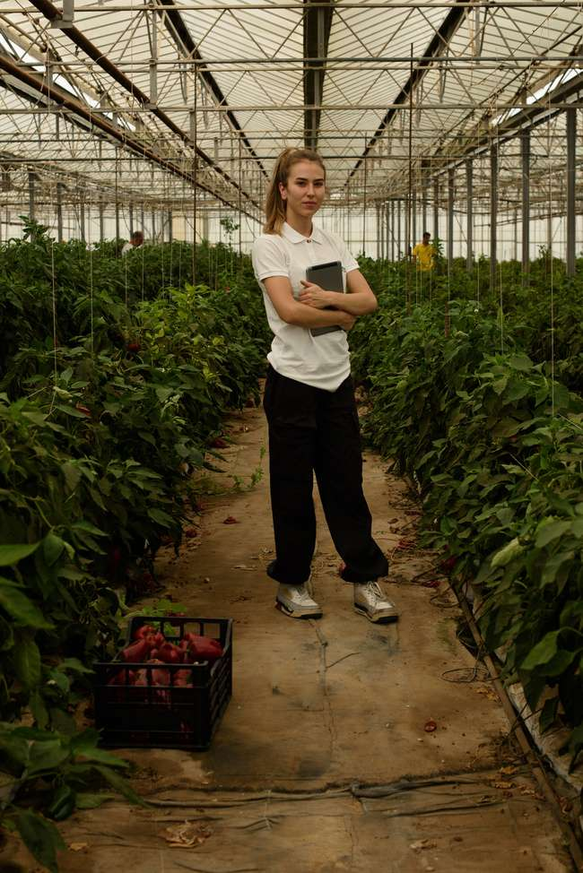
SMART GARDENING SYSTEM
PAGE 03
Problems faced by gardeners:
Difficulty in monitoring environmental conditions remotely.
Manual watering or lighting adjustments.
Problem
Importance of automation and IoT
Improves efficiency.
Saves time and water.
Enables remote monitoring and control.
Why a Smart Gardening System? Traditional gardening methods face challenges
Notes:
Gardening can be tedious without proper tools to monitor environmental conditions. For example, manually checking temperature and humidity levels is time-consuming, and overwatering or underwatering can harm plants. Additionally, traditional systems lack automation and remote accessibility. This project introduces a solution that automates these processes, ensuring plants receive optimal care.

Slide 4
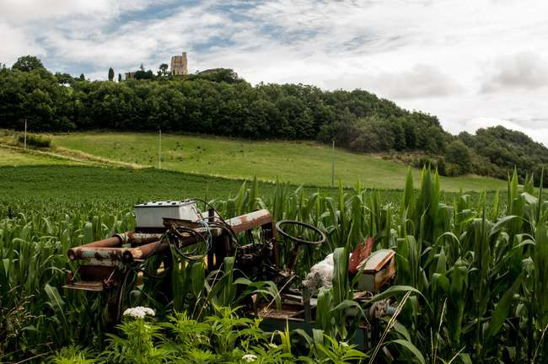
SMART GARDENING SYSTEM
PAGE 04
Solution: Smart Gardening System
Build an IoT system that:
Monitors temperature and humidity using a DHT22 sensor.
Logs data for analysis and visualization.
Provides remote control for gardening actuators.
Displays real-time system status for easy diagnostics.

Slide 5
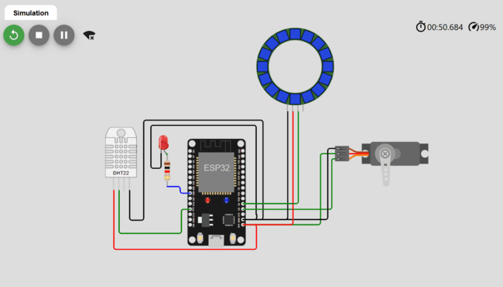
SMART GARDENING SYSTEM
PAGE 05
How Does It Work?
Microcontroller
ESP32: Acts as the central processing unit.
Reads sensor data from the DHT22.
Communicates with the MQTT broker via WiFi.
Executes commands to control actuators like the servo motor and NeoPixel LEDs.

Slide 6
SMART GARDENING SYSTEM
PAGE 06
System Architecture
Sensor
Actuators
Dashboard
DHT22: Measures temperature and humidity.
Data is captured and sent to the ESP32 for processing.
Servo Motor: Performs as a positioning tool.
NeoPixel LEDs: Provides ambient lighting for better plant growth.
Blue Light: Promotes vegetative growth.
Red Light: Stimulates flowering and fruiting.
Green Light: Less absorbed by chlorophyll but can penetrate deeper into plant tissue.
LED: Shows the sustainability of the connection.
Node-RED Dashboard: Displays real-time temperature and humidity data using gauges and charts.
Servo Motor: Adjust its position remotely.
NeoPixel LEDs: Customize colors using an RGB color picker.
Communication Protocol
MQTT: Enables real-time data transfer between the ESP32 and the Node-RED dashboard.

Slide 7
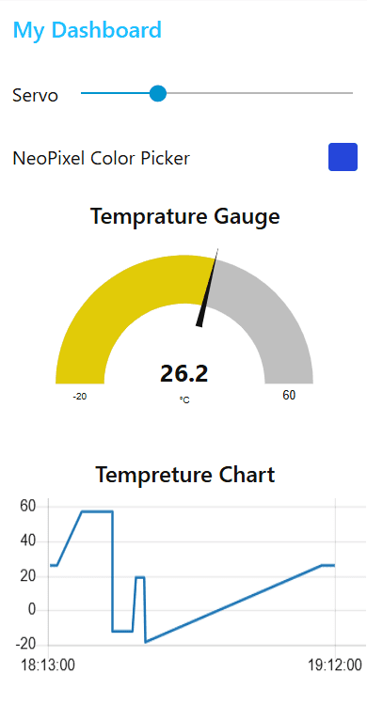
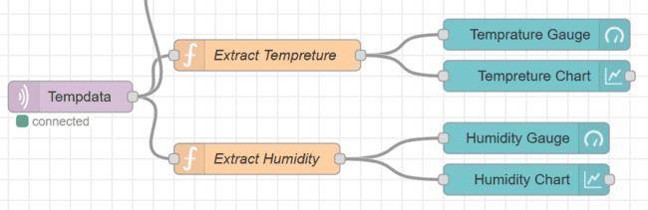
SMART GARDENING SYSTEM
PAGE 07
Node-RED Dashboard
key controls
Temperature and Humidity Gauges: Real-time monitoring.
Servo Control: Adjust motor position.
NeoPixel Color Picker: Set LED colors remotely.
Logging Buttons: Toggle temperature and humidity data logging.

Slide 8
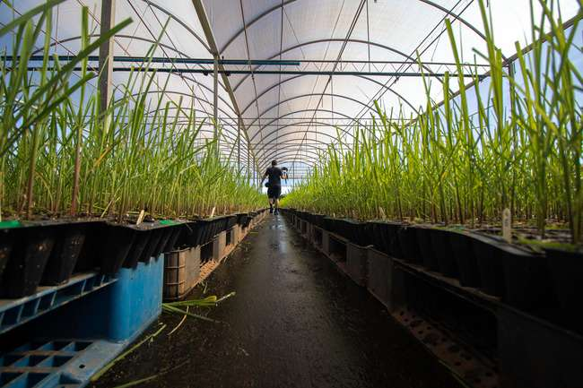
SMART GARDENING SYSTEM
PAGE 08
Key Features of the system
Monitoring
Control
Automation
Real-time data for temperature and humidity.
Remote access via dashboard.
Adjust servo position.
Customize NeoPixel colors.
Automatic LED status based on WiFi connection.

Slide 9
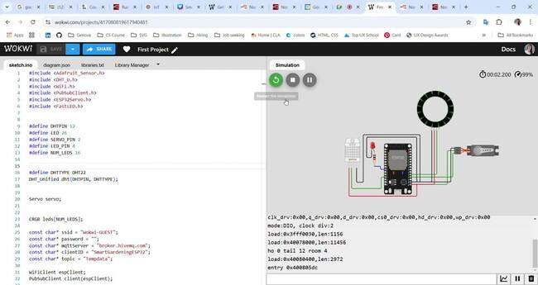
Demo
SMART GARDENING SYSTEM
PAGE 09

Slide 10
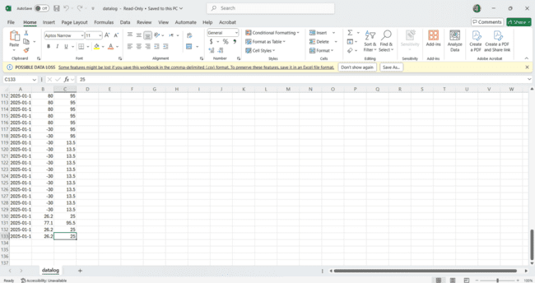
DHT Log

Slide 11
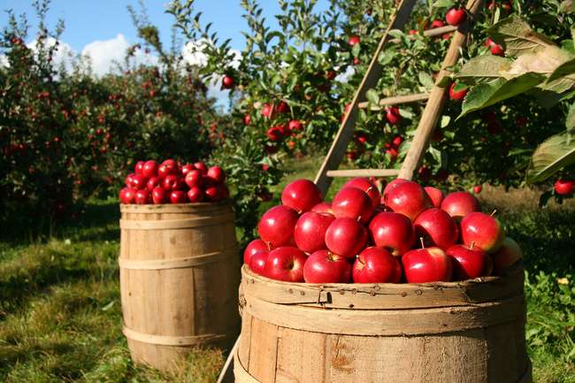
SMART GARDENING SYSTEM
PAGE 10
Future Enhancements
Soil moisture sensor for better gardening insights.
Automated watering based on soil conditions.

Slide 12
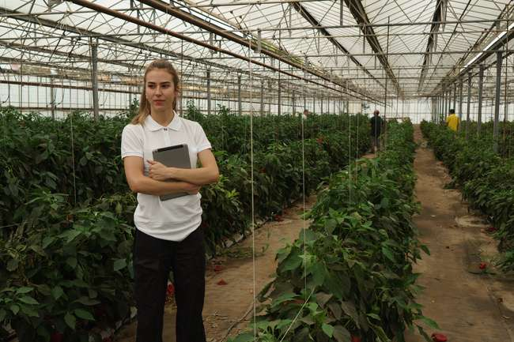
SMART GARDENING SYSTEM
PAGE 11
Appreciate Your Attention
Monitoring, control, and automation in gardening.
Use of IoT and Node-RED for a scalable solution.
ZEINAB GHOLAMPOUR DADAEI
S6117047@STUDENTI.UNIGE.IT

